Slide 1

Project - Power consumption prediction
By – Deepak Pal
Email – deepak.pal18x@gmail.com

Slide 2
Objective -
Our objective is to create an accurate machine learning model that predicts the power consumption in Zone 1 of Wellington. By achieving this, we can contribute to effective energy resource management, cost reduction, and a more sustainable future for the region. we'll explore how utilizing environmental and meteorological factors can assist in efficiently managing energy resources and optimizing power consumption.

Slide 3
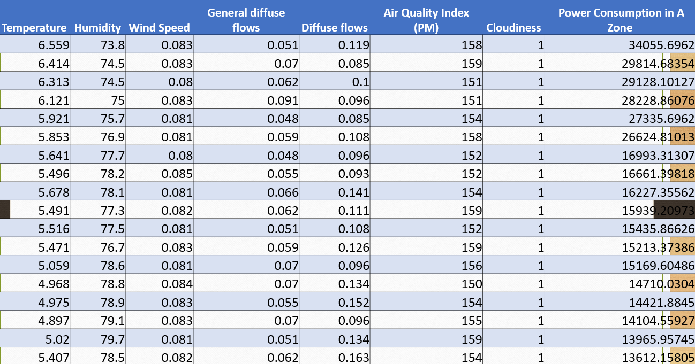
Data Structure
No_of_columns – 8
No_of_Rows – 52583
Target column - Zone 1 Power Consumption

Slide 4
Exploratory Data Analysis (EDA)
Shape - (52583, 8 )
Temperature, Humidity and Wind Speed being numeric data columns ,were classified as object dtype due to having of wrong data type like strings ,’5.567 dc’.
Temperature, Humidity, Wind Speed, general diffuse flows, diffuse flows, Air Quality Index (PM) have small fraction of outlier and columns have some missing data.
Exploratory data analysis provided valuable insights into the dataset. Visualizations such as histograms, scatter plots, and correlation matrices revealed patterns and correlations among variables, guiding our model development process.

Slide 5
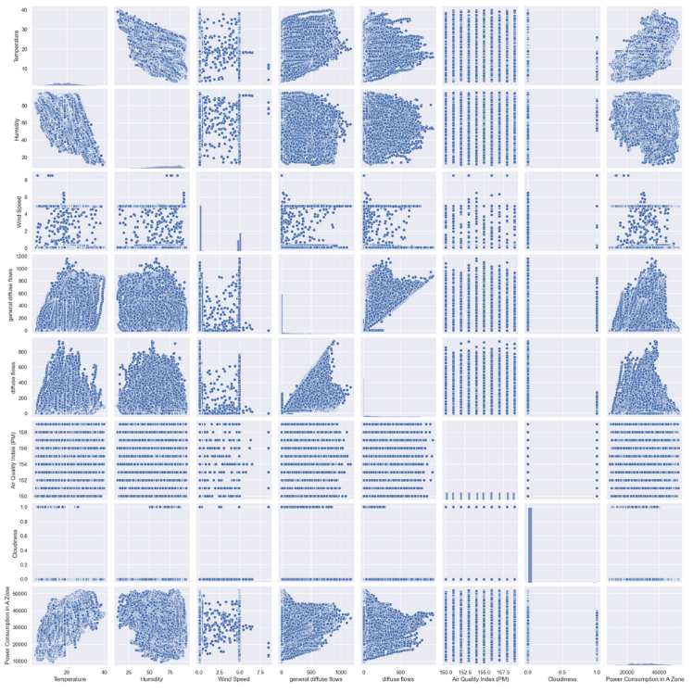
Pair plot
To visualize relationship of features with one and another.

Slide 6
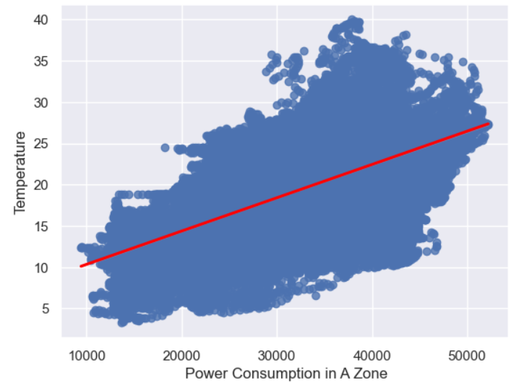
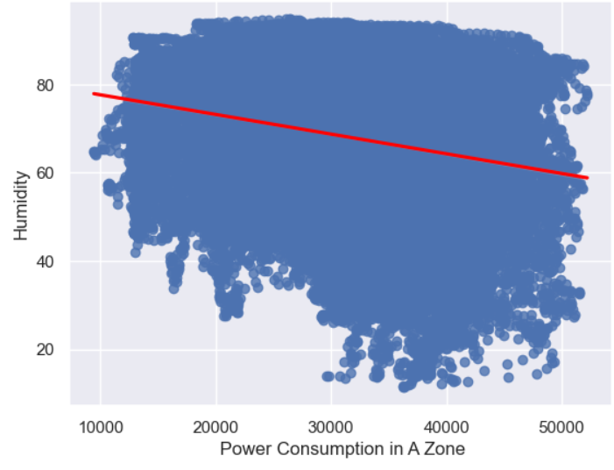
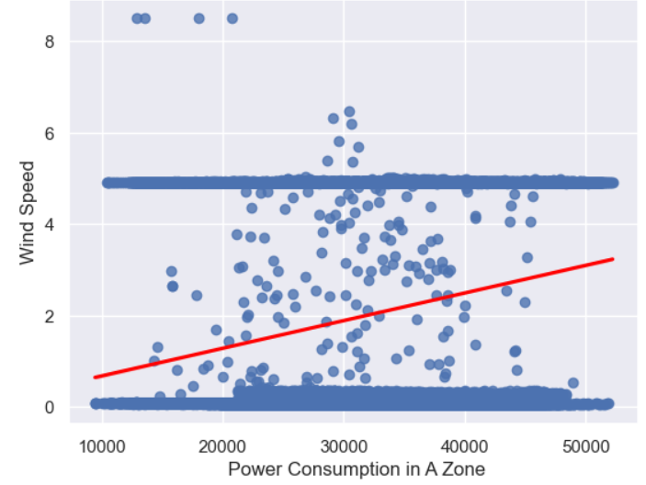
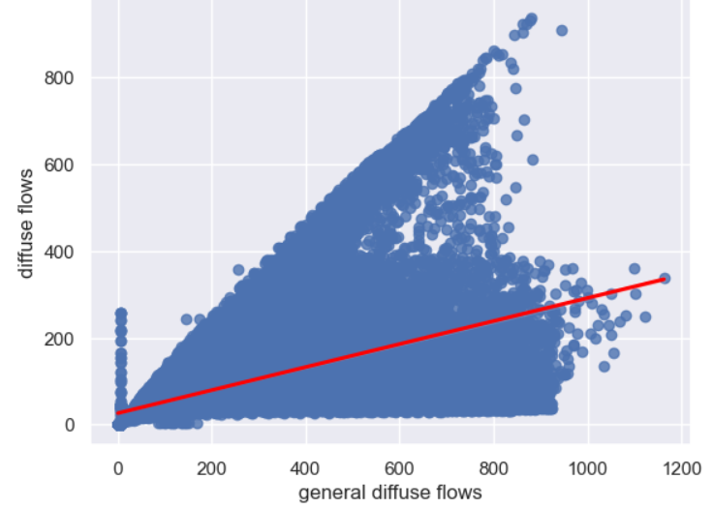
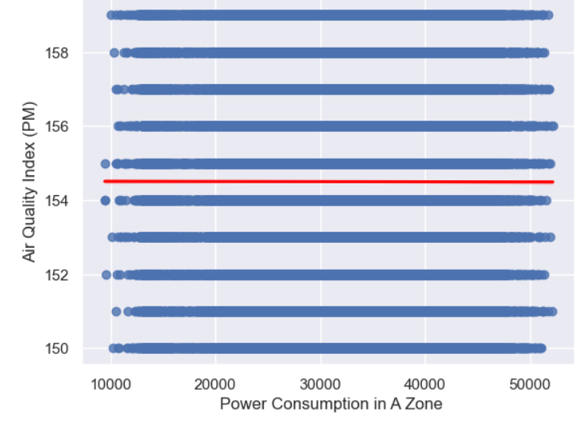

Slide 7
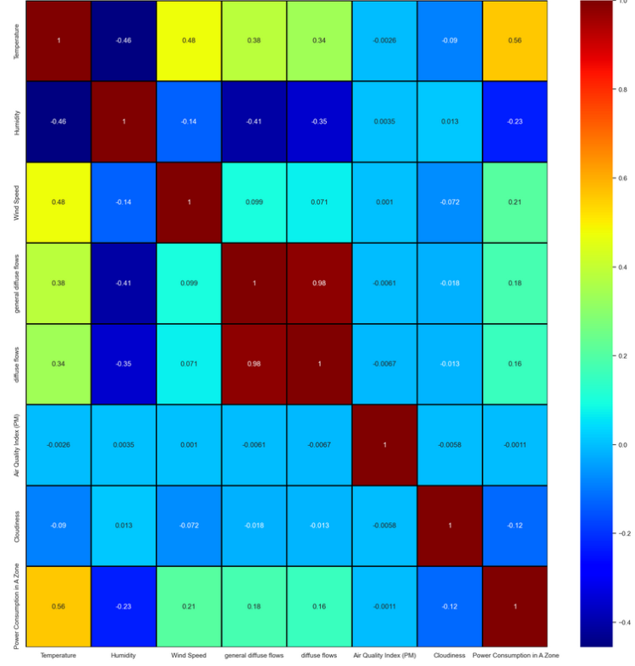
Co-relation Matrix
Findings -
1) Temperature and humidity are negatively correlated by - 0.46(moderate)
2) Temperature and windspeed are positively correlated by - 0.48(moderate)
3) General diffuse flows and diffuse flows are highly correlated by -0.97
4) humidity and General diffuse flows are negatively correlated, negatively correlated by - -0.41

Slide 8
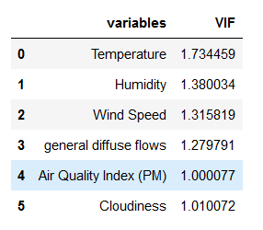
More EDA
Skewness Treatment By yeojohnson method.
Dropping highly correlated column diffuse flow.
Checked for Variable inflation factor for Multicolinearity check.

Slide 9
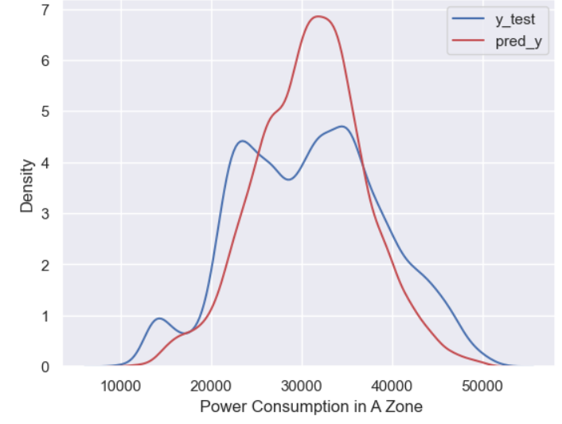
Model Building
Model – RandomForestRegressor
Train & Test accuracy - 0.9 & 0.65
mean_absolute_error - 3493.44
Adjusted R^2 - 0.6289

Slide 10
Thank You

